Slide 1

hTTP 2.0
Sai Sundeep Innamuri
Rajeev Bhupathiraju

Slide 2
Contents
Introduction to Http/2.0
Http Pipelining
HOL Blocking
Http multiplexing
Streams and frames
Http Server push
Flow control
Header compression
Differences from http 1.1
Advantages and criticism
Conclusion

Slide 3
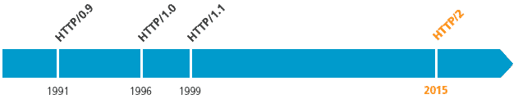
Introduction
HTTP is an application protocol for distributed, collaborative and hypermedia information systems.
Hypertext is structured text that uses hyperlinks between nodes containing text.
HTTP is the protocol to exchange or transfer hypertext.
Development of HTTP was initiated by Tim Berners-Lee(inventor of world wide web) at CERN in 1989
Four major version till date. Version 2.0 was released in 2015

Slide 4


Introduction - Http/2
Web is being used differently that how it was envisioned
HTTP2 (HTTP/2.0) is a major revision of HTTP network protocol used by the World Wide Web.
developed from the SPDY(speedy) protocol, developed by Google.
As of January 2017, 12.7% of the top 10 million websites supported HTTP/2.

Slide 5

Why h2
Why h2
Websites getting bigger .more images , more CSS more thing to download
Bandwidth increasing exponentially, but not RTT.
Initially one TCP connection for one HTTP 1.0 request
due to the TCP slow start, multiple resource files were combined in to one for performance.

Slide 6
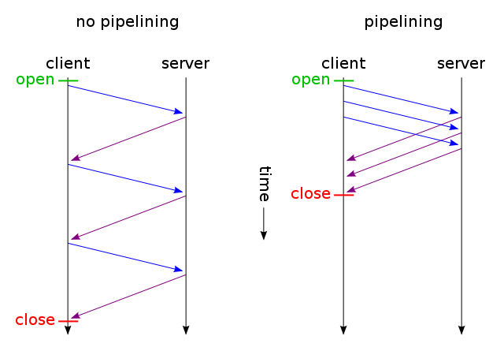
Why h2 - contd..
Small files on one or multiple connection gives better http throughput
This issue was addressed by some simple hacks like keep-alive header, HTTP 1.1 pipelining, multi-threading, Sharding etc..
Chrome uses max of 6 simultaneous connections to one server.
But multi-threading and pipelining faces issues with HOL blocking

Slide 7
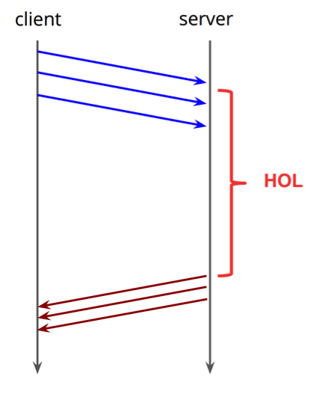
Hol blocking
For pipelining to work the requests must be served in the order they are served.
When one request takes much time be served, the following requests just wait.
HOL blocking is a performance-limiting phenomenon that occurs when a line of packets is held up by first packet
Http/2 is the solution for this asynchronous operation

Slide 8
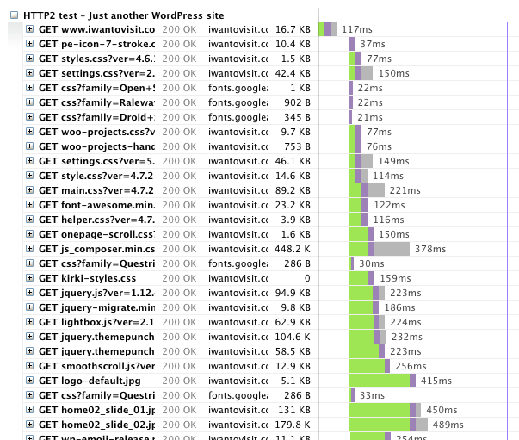
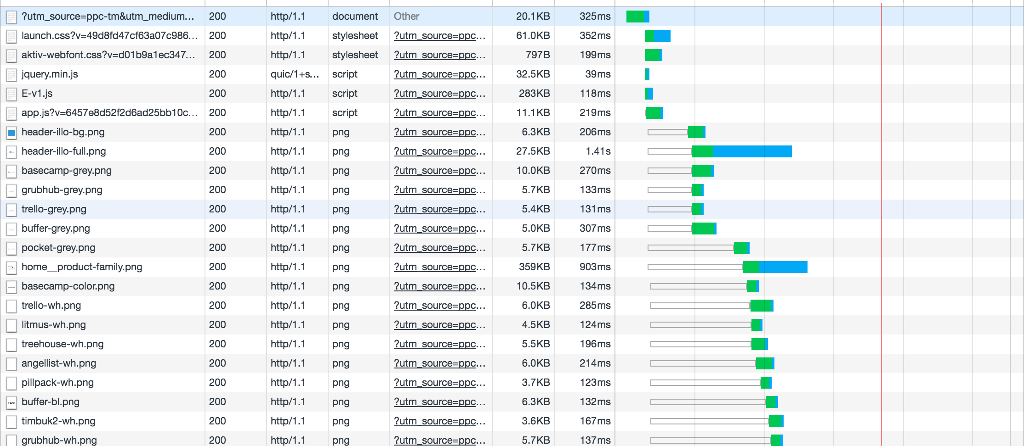
HTTP 1.1 vs H2 In performance

Slide 9
Http Multiplexing
Multiplexing is a method in which Http requests are sent and responses are received asynchronously using a single TCP connection
Multiplexing is considered to be the heart of Http/2 protocol
Http multiplexing is a re-use of established server connections for multiple clients connections

Slide 10
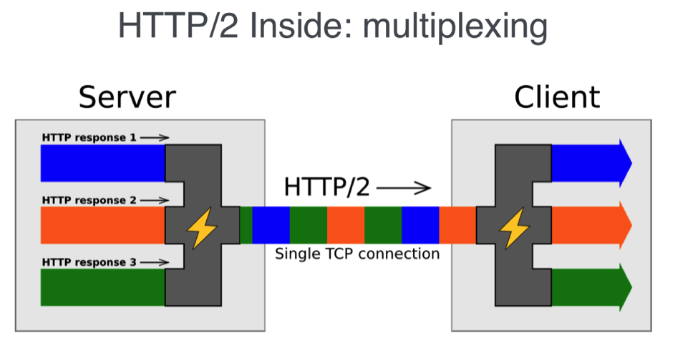
Http Multiplexing
To create Http request, first client divides request into binary frames and assigns the stream ID to the frames
The client starts sending frames to the server after the TCP connection is initiated
Once the response is ready in the server, it divides the response into frames and assigns the same stream Id and the response is sent
The client will receive and arrange the response based on stream Id

Slide 11
Frames and Streams
Http/2 is a binary protocol
Each and every request and response in Http/2 are given an unique Id called as stream Id
An Http request and response is divided into frames

Slide 12
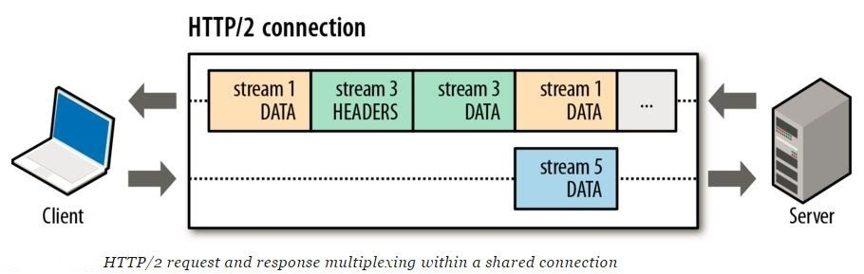
Streams
Stream Id is basically used to identify to which request and response a frame belongs to
A TCP connection can have multiple streams

Slide 13
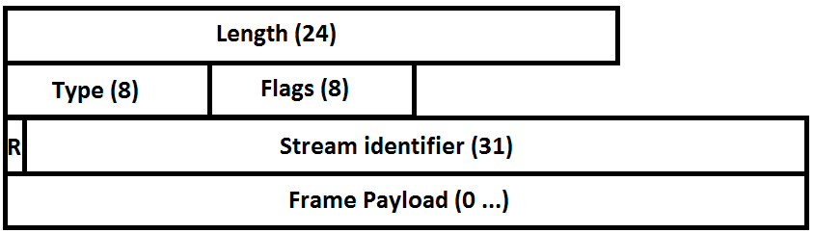
Frames
The smallest unit of communication within an Http/2 connection
Frames are binary pieces of data
Once the HTTP/2 connection is established, endpoints can start exchanging frames

Slide 14
Multiple Http requests
Once a TCP connection is established all requests for that origin is done via that TCP connection
Multiple http/2 requests are divided into frames and assigned respective stream Id’s
The request and response both happen simultaneously, while client is sending frames, server also sends the response frames back to client

Slide 15
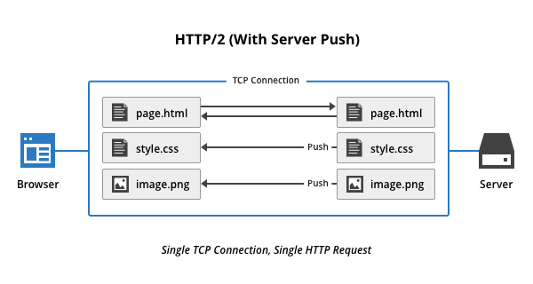
Http Server Push
Http/2 allows a server to push responses to clients in association with previous client-initiated request
Server push is semantically equivalent to a server responding to a request, but in this case, that request is also sent by the server
Push is a frames protocol

Slide 16
Flow control
Flow control is a method of controlling the rate of transmission between client and server
When the HTTP/2 TCP connection is established, the client and server exchange SETTINGS frames first, indicating
i) how many streams can be open at a time
ii) how many bytes server is ready to receive for a stream
iii) the rate at which data can be delivered or received

Slide 17
Prioritization
Client can assign a priority for a new stream by including prioritization information in the headers frame
Using the priority values server decides how much memory, CPU time and bandwidth needs to be given to a request
Basically server sends the frames of multiple requests asynchronously without any order and process them parallelly
But priority can force server to send frames of a response before other responces

Slide 18
Header Compression
One compression context and one decomposition context are used for entire connection
Headers can be compressed using Huffman encoding algorithm
Hpack compression reduces the size of your headers by 30% on average and reduces overhead
Another advantage of Hpack is that it uses indexing

Slide 19
Encryption
Http/2 is defined for both Http URI’s(i.e, without encryption) and for Https URI’s( requires encryption)
Although Http/2 does not require usage of encryption, most client implementations (Firefox, chrome, safari, opera, IE, Edge) have stated that they will only support Http/2 over TLS(transport layer security), which makes encryption in fact mandatory

Slide 20
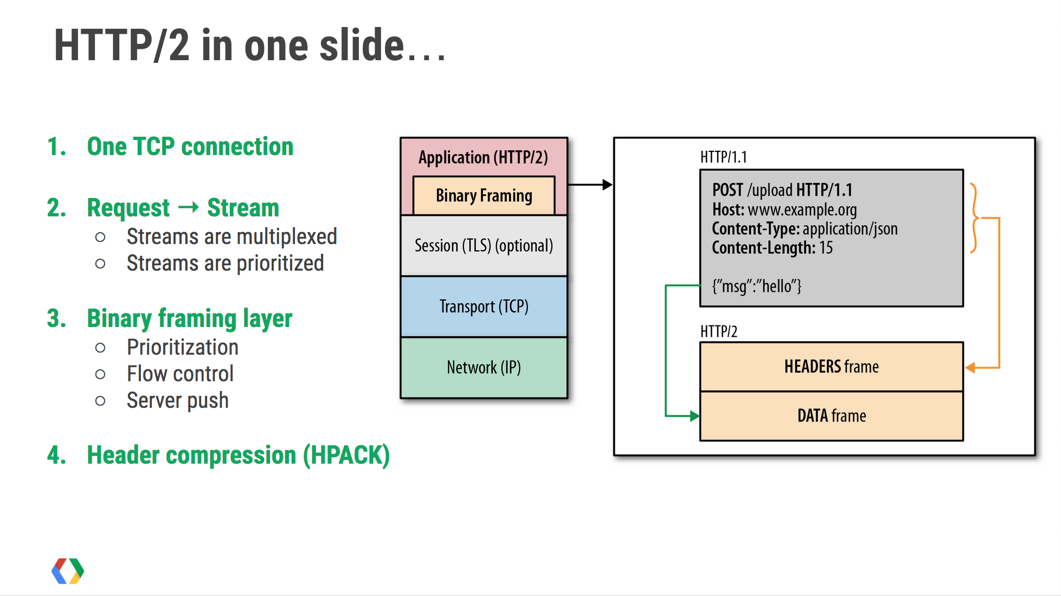
Http/2 in one slide

Slide 21
Differences from Http 1.1
Http/2 leaves most of Http 1.1’s high-level syntax, such as methods, status codes, header fields and URI’s the same.
Only change is the bits on the wire
Http is extending, not replacing the previous HTTP standards
Http/1.1 uses Pipelining to send the data where as Http/2 uses Multiplexing for sending the data

Slide 22
Advantages Criticism
Doesn't support opportunistic encryption
Reduced latency
Single connection
Multiplexing
Server push
Prioritization
Binary Header compression

Slide 23
Http/2 support Browsers
Google chrome
Mozilla Firefox
Internet Explorer
Safari
Opera
Microsoft Edge
Amazon Silk

Slide 24
Conclusion
Http/2 is successful in increasing the efficiency and successful as an updated version using multiplexing as data exchange

Slide 25
References
https://tools.ietf.org/html/rfc7540
https://en.wikipedia.org/wiki/HTTP/2
https://en.wikipedia.org/wiki/HTTP_pipelining
http://qnimate.com/what-is-multiplexing-in-http2/
https://http2.github.io/http2-spec/
http://searchengineland.com/everyone-moving-http2-236716
https://en.wikibooks.org/wiki/Communication_Networks/HTTP_Protocol

Slide 26

Questions?

